Slide 1
ALPINE LODGE
BY DIPANKAR ROY
&
SANGYE TENPHEL

Slide 2
INTRODUCTION
It is a website for lodge management system.
Serve as a local social environment.
To develop a set of information sources.
Digital branding.
Mobile responsive.
Feedback and Email promotions.

Slide 3
TOOLS USED
FRONT-END
BACK-END
HTML
CSS
PHP
MYSQL

Slide 4
WEBSITE DESIGN
FRONT-END
BACK-END
Minimalistic design
Contains 3 sections:
Home
About
Contact
Login and registration page
User dashboard

Slide 5
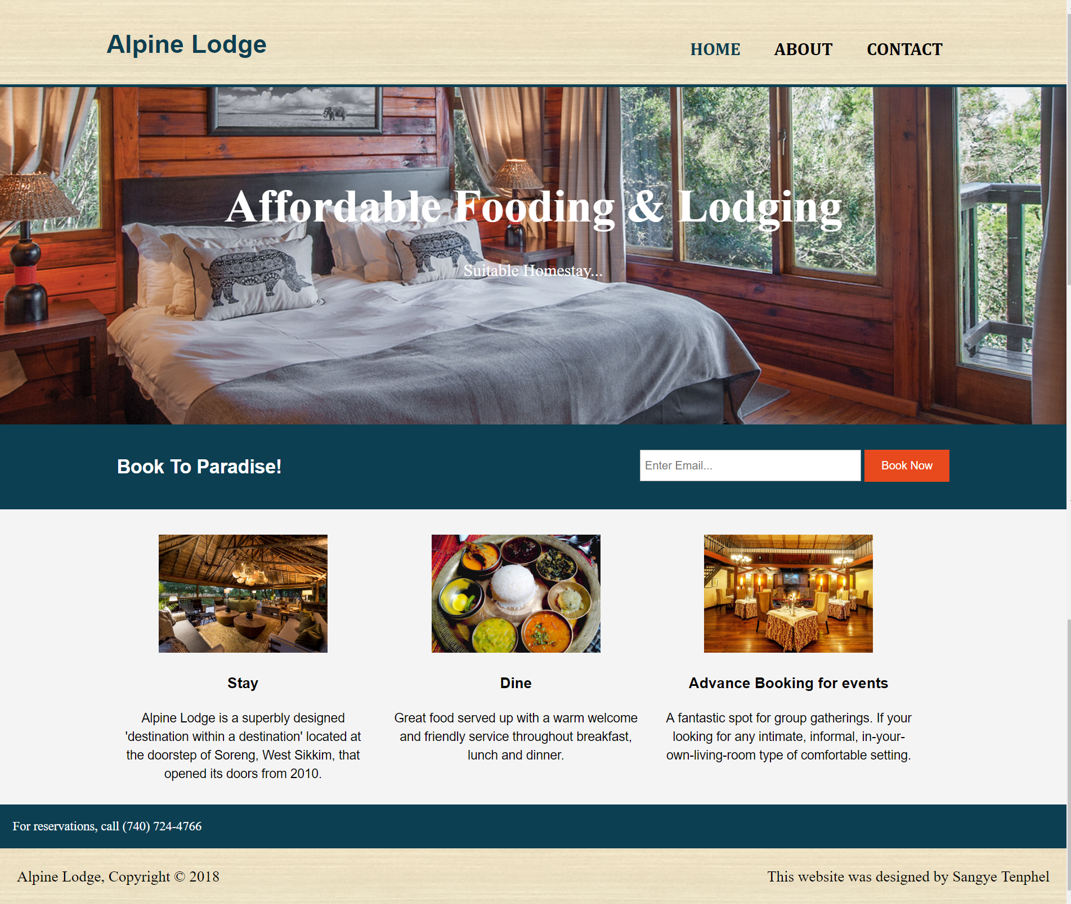

Slide 6
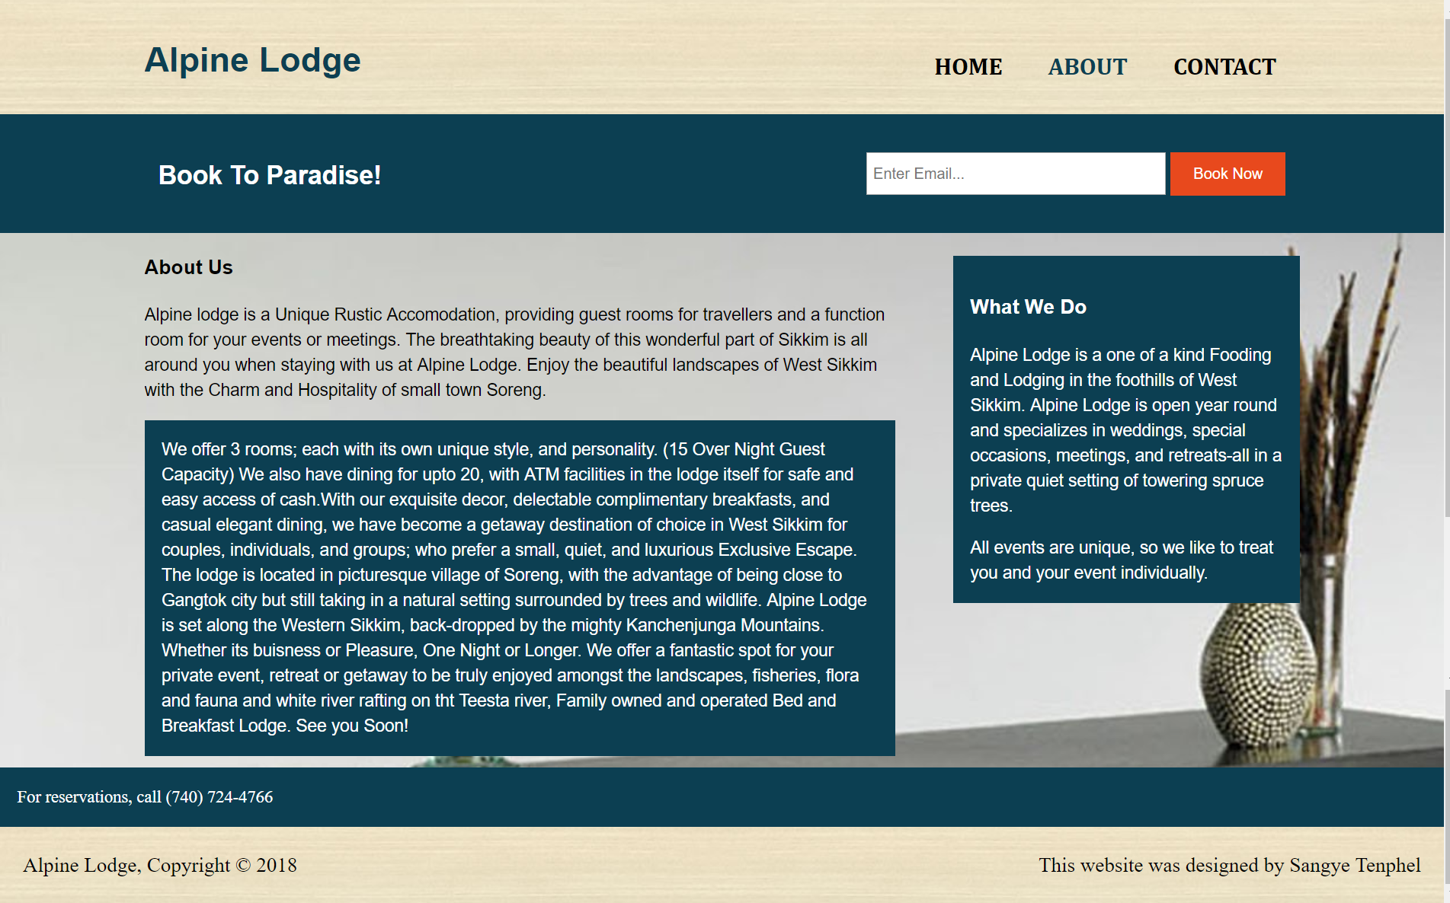

Slide 7
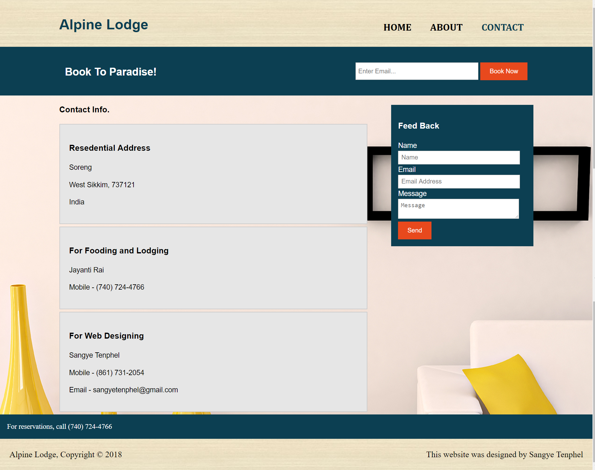

Slide 8
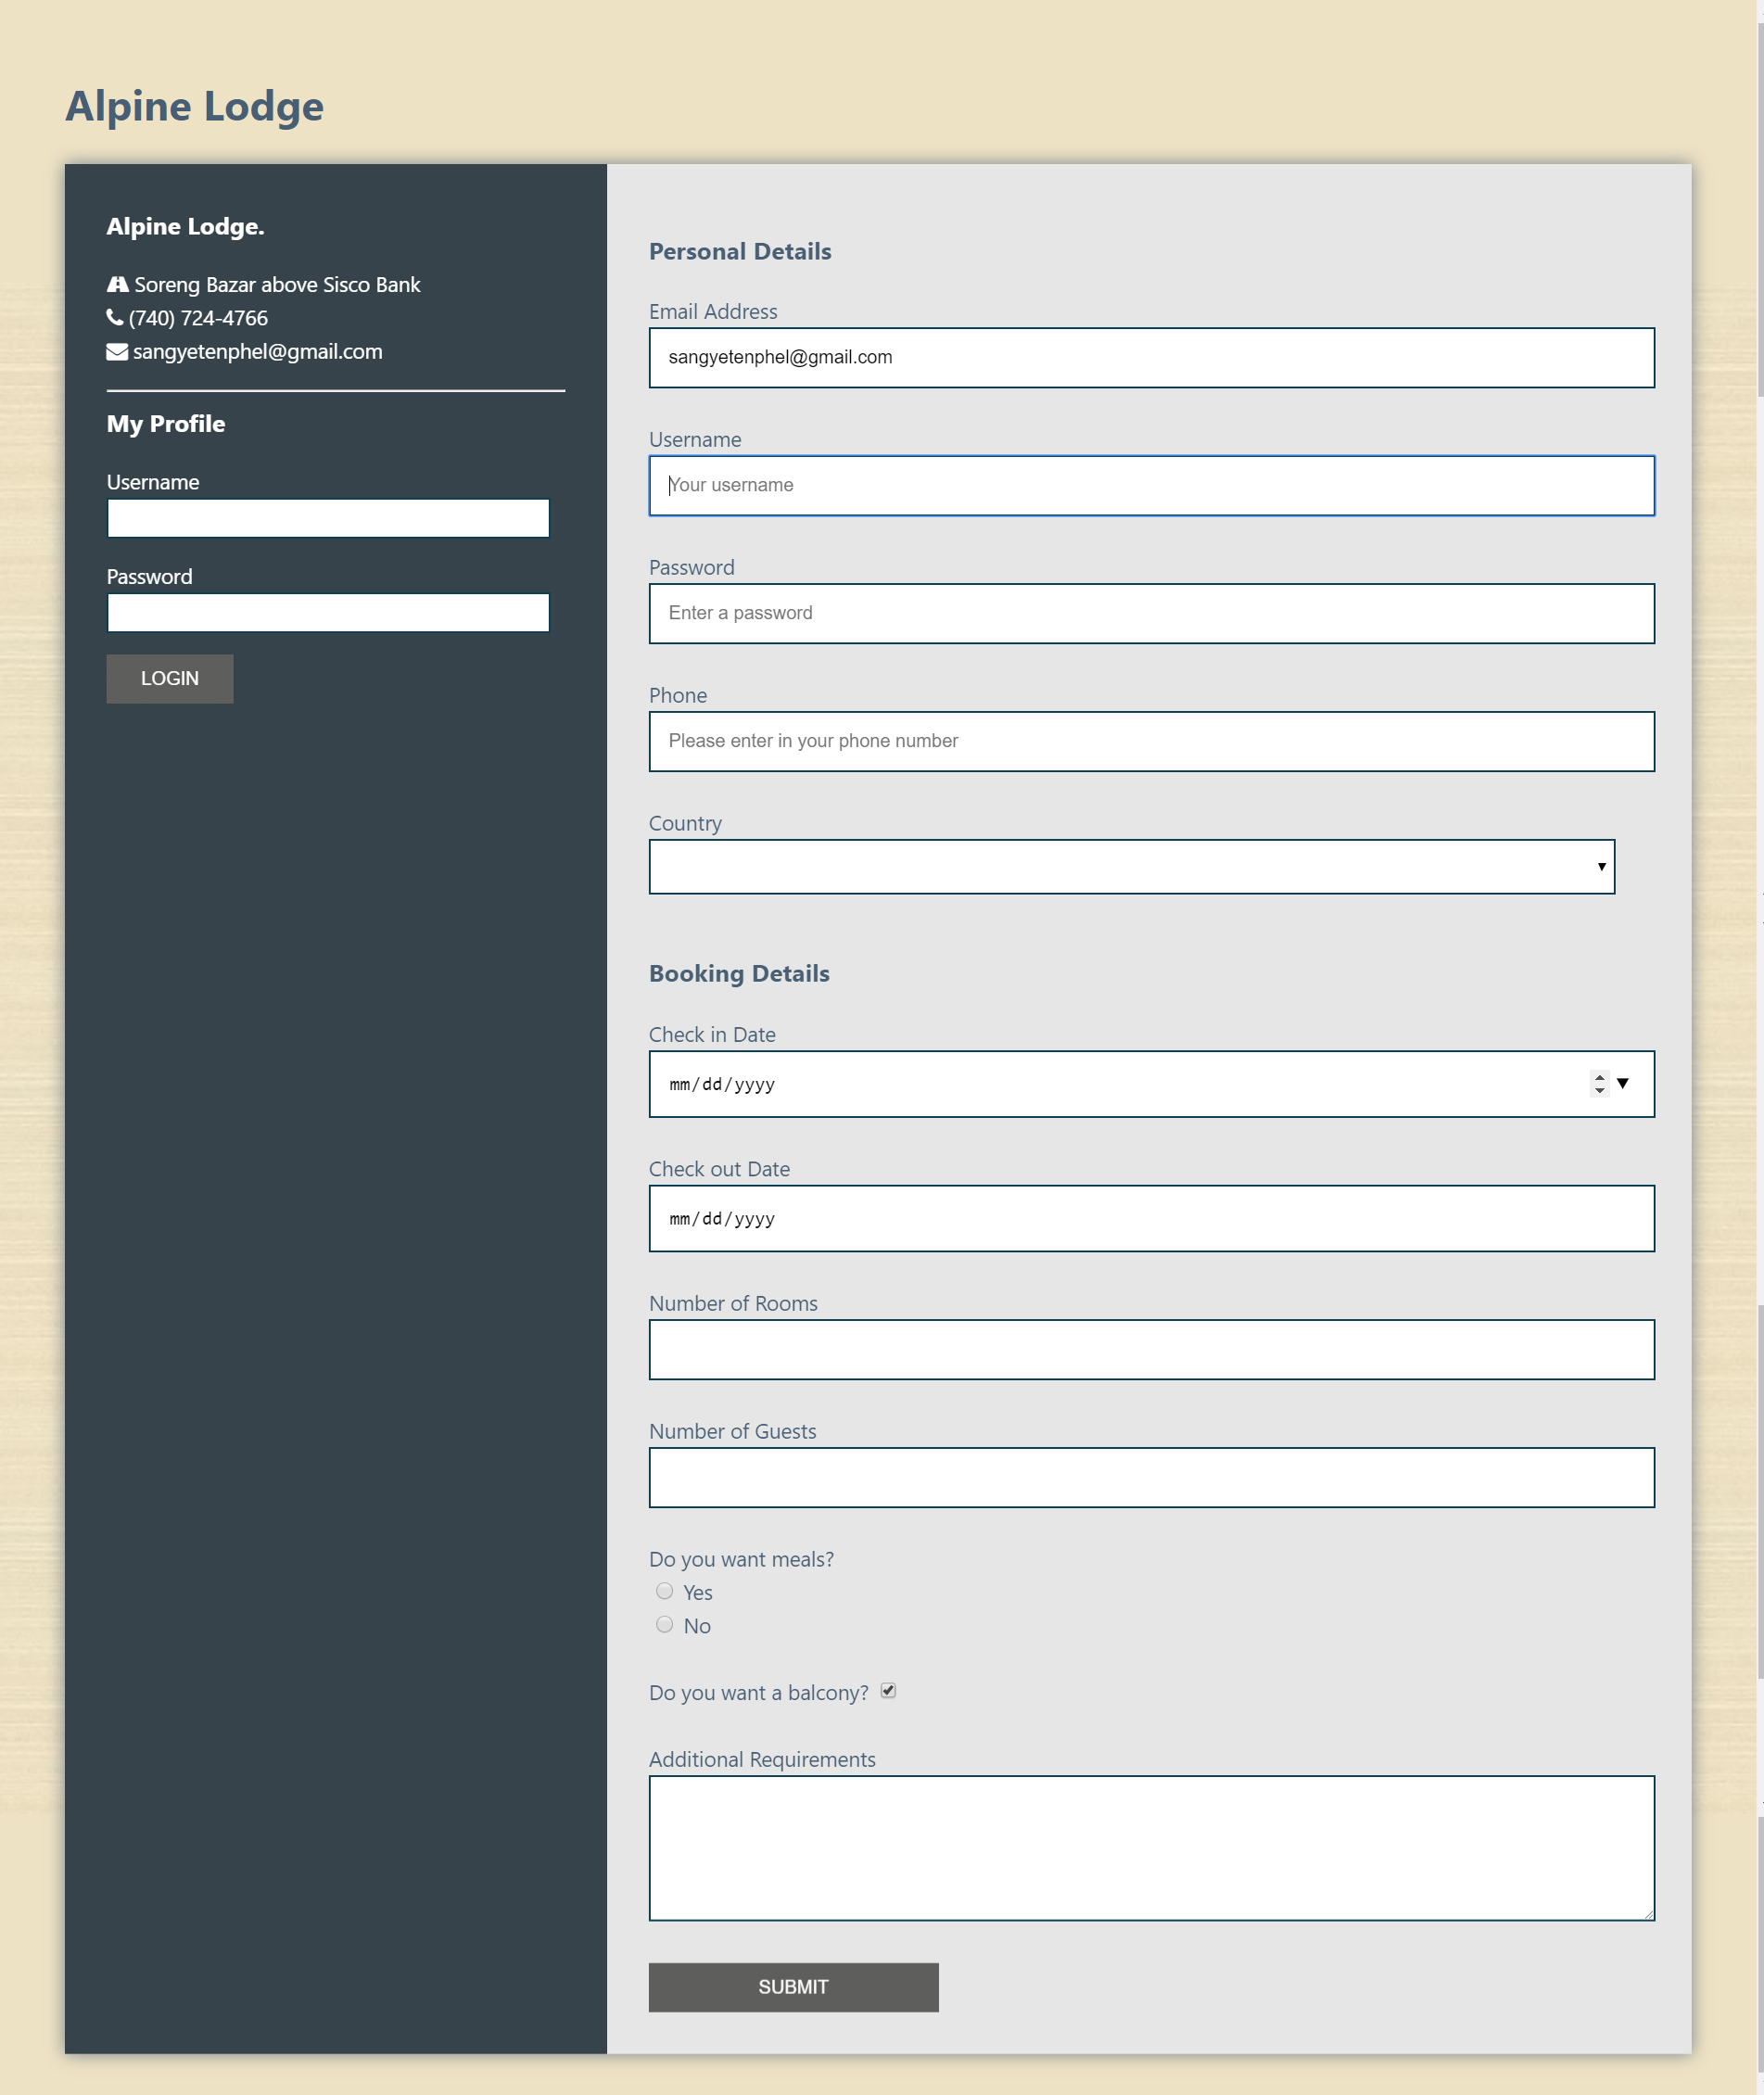

Slide 9
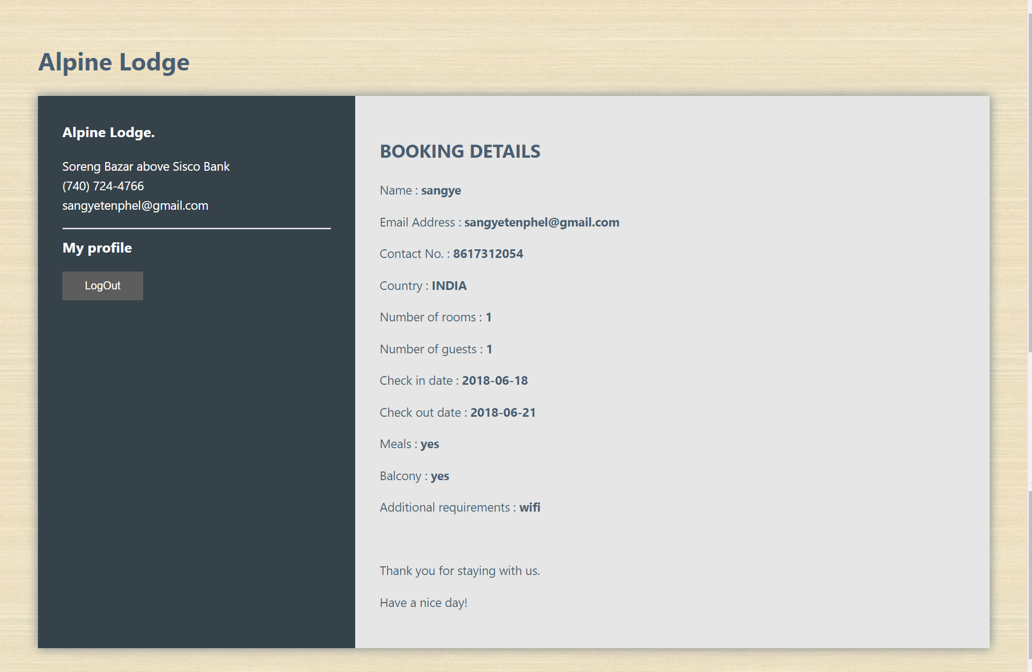

Slide 10
WORKING OF THE PROJECT
The following DFD and Entity Relationship Diagram shows how the site functions.

Slide 11
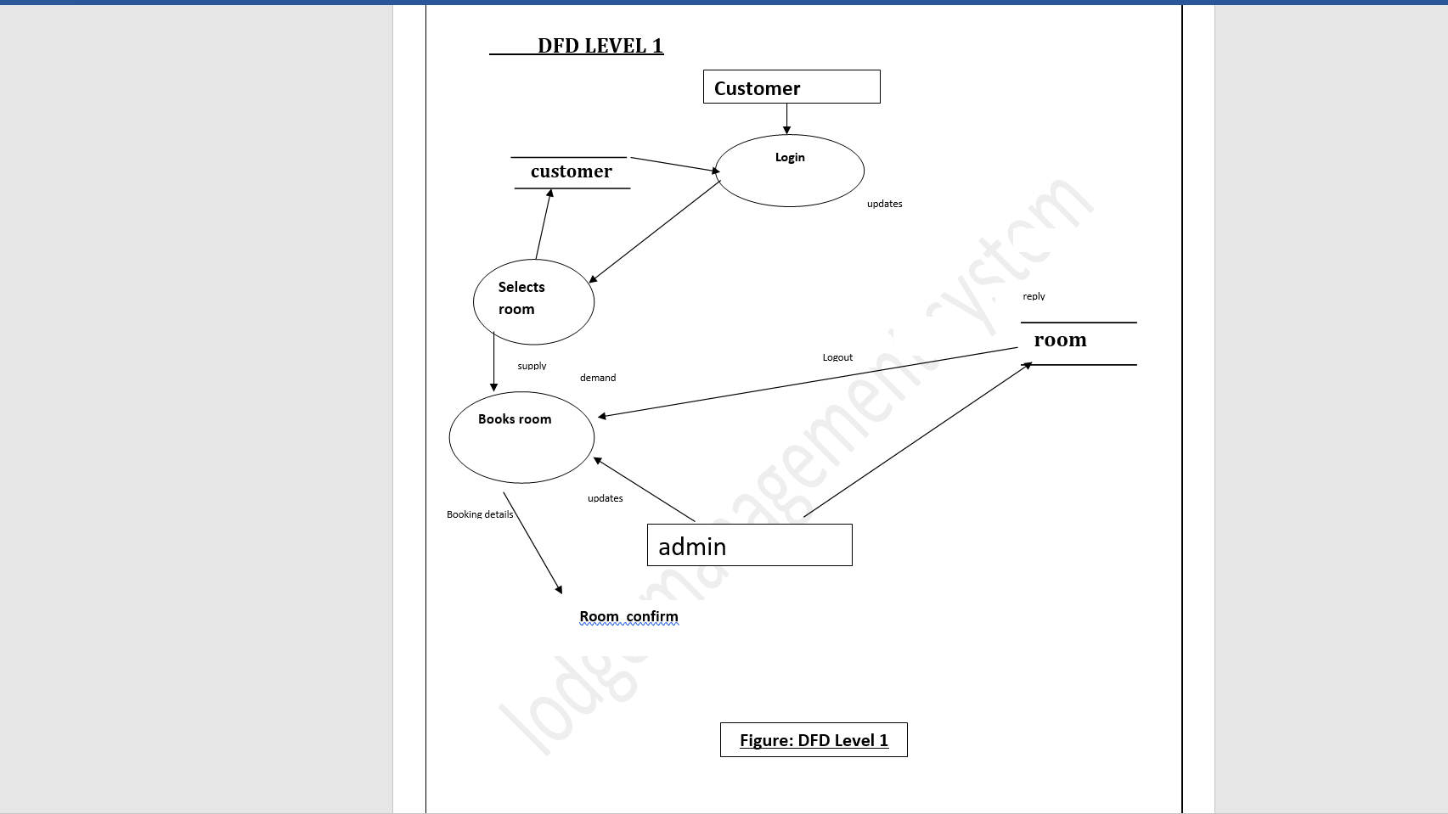

Slide 12
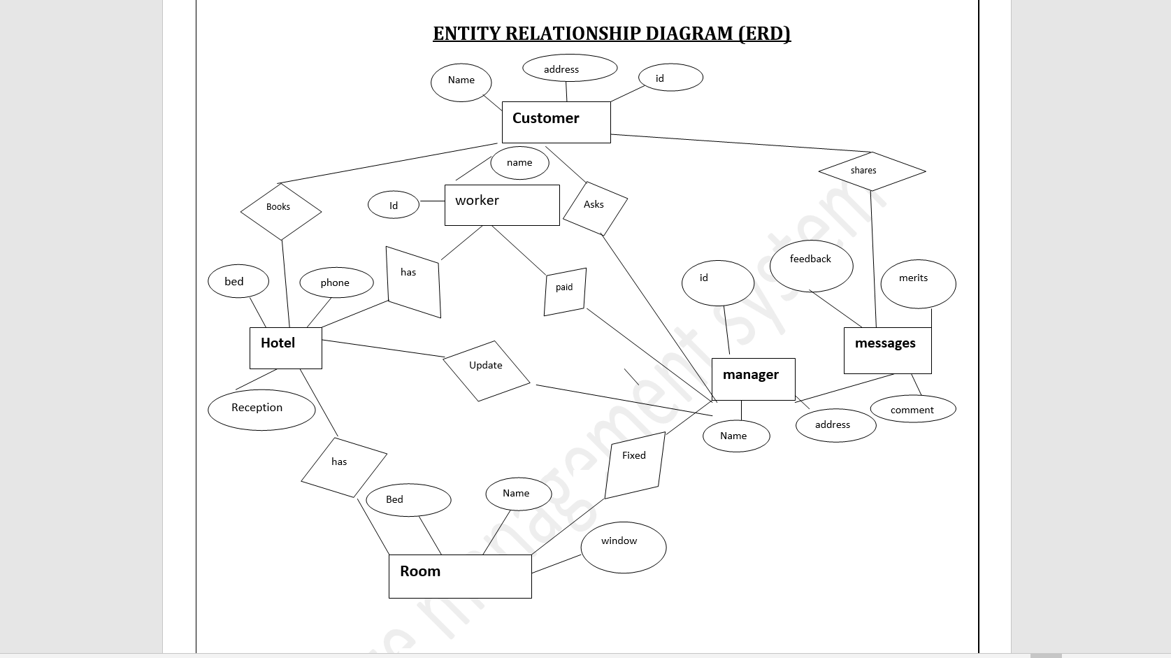

Slide 13
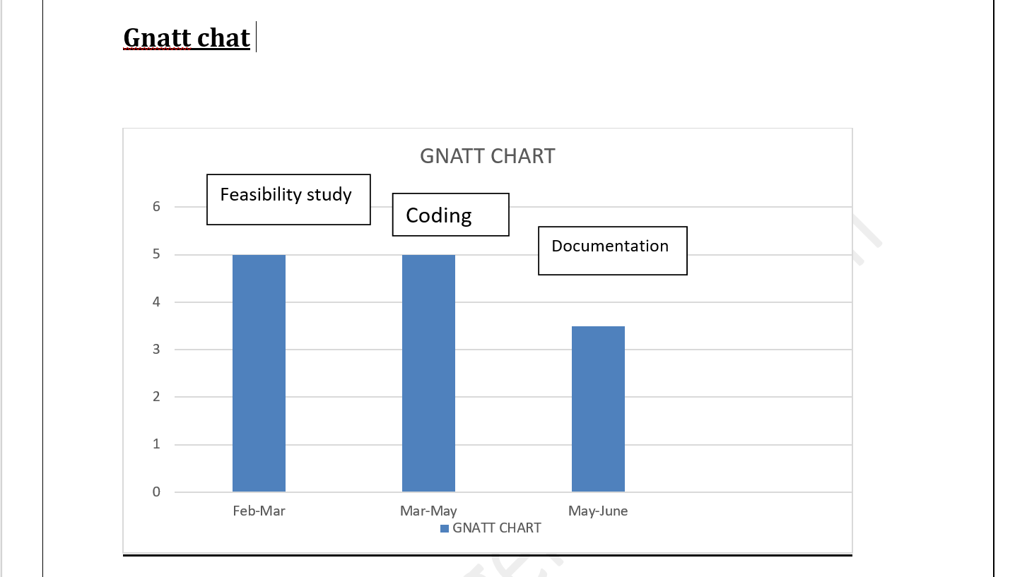

Slide 14
FUTURE SCOPE
Live weather widget
Artificial Intelligence, Virtual Reality and Augmented Reality images and videos of rooms, sites etc. for better user experience.

Slide 15
CONCLUSION
Alpine lodge is a website beneficial for the people looking for a place to stay at a reasonable rate.
Any one can easily and comfortably book using this website.
This project is designed to meet the requirement of online lodge management.
It has been developed in different languages i.e. html, css, php and mysql.

Slide 16
THANK YOU

